Slide 1
“IN THE NAME OF ALLAH THE MOST BENEFICENT THE MOST MERCIFUL”

Slide 2


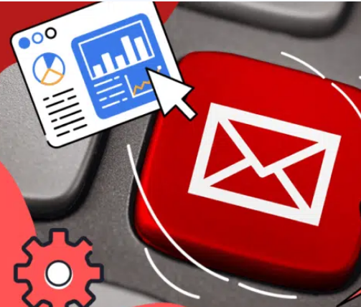
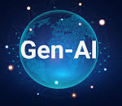

Personalized Email Chatbot Email Personalization Outreach Campaign Agent
Gen-AI
Gen-AI
Gen-AI
Gen-AI

Slide 3
Problem Statement
Problem 1: Lack of Proper Engagement due to heavy workload.
Problem 2: Not Delivered customized contents on the emails.
Problem 3: Marketers and suppliers reads the email with the subject’s name, then ignore the email body.
Problem 4: Not enough time for searching the company decision making concerns.
Problem 5: Not enough time to reach the companies, supplier and need to be identify their needs.

Slide 4
Project Overview
Our mission is to develop and deploy multiple AI agents using Crew AI or AutoGen for top-tier email content personalization.
Searching Agent: 🌐 Real-time internet search to explore websites, like (COMET Estimating LLC) (Any name like Mustafa Shoukat) and other platforms.
NER Agent: Named Entity Recognition for extracting important information.
Sales Agent 3: 💼 Expert on our company and its offerings.
Lead Sales Agent: 🎯 Converts leads into actionable customers, HR, or decision-makers.
Email Writer Agent: ✉️ Transforms lead data into a personalized, actionable email for HR or decision-makers.

Slide 5
Methodology Used in Project
Front-End Tools and Frameworks:
User Input: Defined through a sleek GUI.
Back-End Tools and Frameworks:
Version Control: Git and VS Code for smooth collaboration.
Backend: Flask to power the engine.
LLMs Configuration: Get those AI brains in gear.
AI Agents: Crew AI or AutoGen to lead the charge.
Outcomes & Output:
Lead Profiles: Detailed profiles highlighting needs and key decision-makers.
Custom Emails: Tailor-made email drafts for targeted outreach.
Increased Conversions: More leads turning into satisfied clients.

Slide 6



Goal and Aim of the Project
AI agents will identify leads, analyze their needs, and craft personalized outreach campaigns to turn interest into action.
A series of personalized email drafts crafted for each lead (Client or Recruiter), addressing their unique needs and aligning with their company culture

Slide 7
Block Diagram
Version Control
Outreach (APP name)
Agent Real time internet searh
Agents Sales Representative writer
Agent Lead to Client or decision maker writer
Manager Agent work Anaysis
User GUI
User input

Slide 8
Group Members Introductions
Member 1: Name: Mustafa Shoukat
Position : Generative AI Engineer
Member 2: Name: Gule Noor
Position : Civil Engineer | Python developer

Slide 9
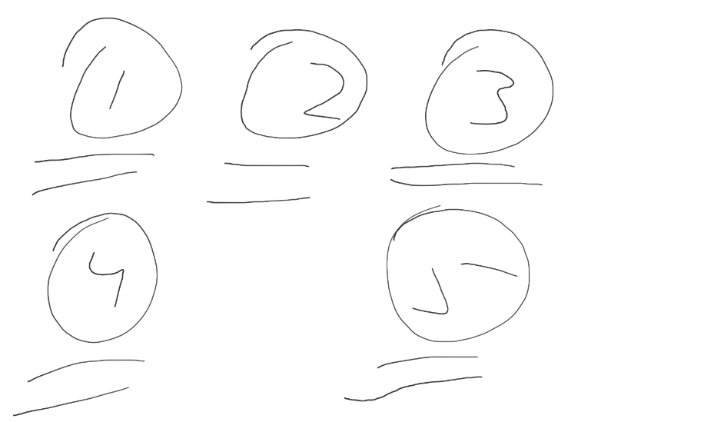
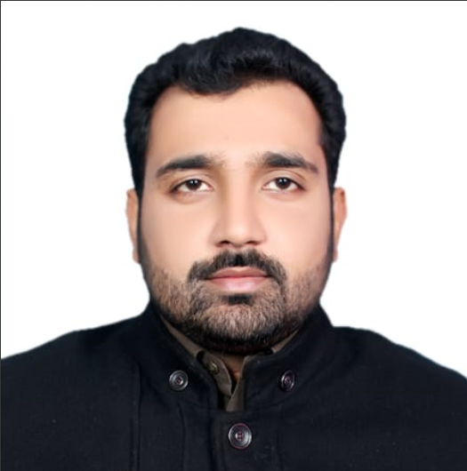
Group Members Introductions
Member 3: Name: Amina
Position: Frontend Developer
Member 4: Name: Aamir Javed
Position: Technical writer

Slide 10
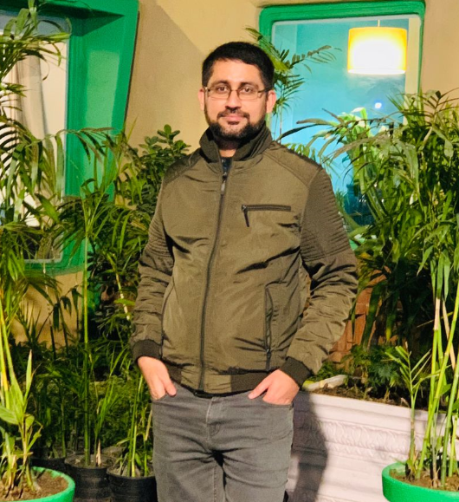
Group Members Introductions
Member 5: Name: Muhammad Faisal Rasheed
Qualification: Mechatronics Engineer | Technical writer

